Slide 1


CS-446: Information Systems Security
Chapter # 14: VPN and Firewalls
Department of Computer Science
FAST-NUCES

Slide 2
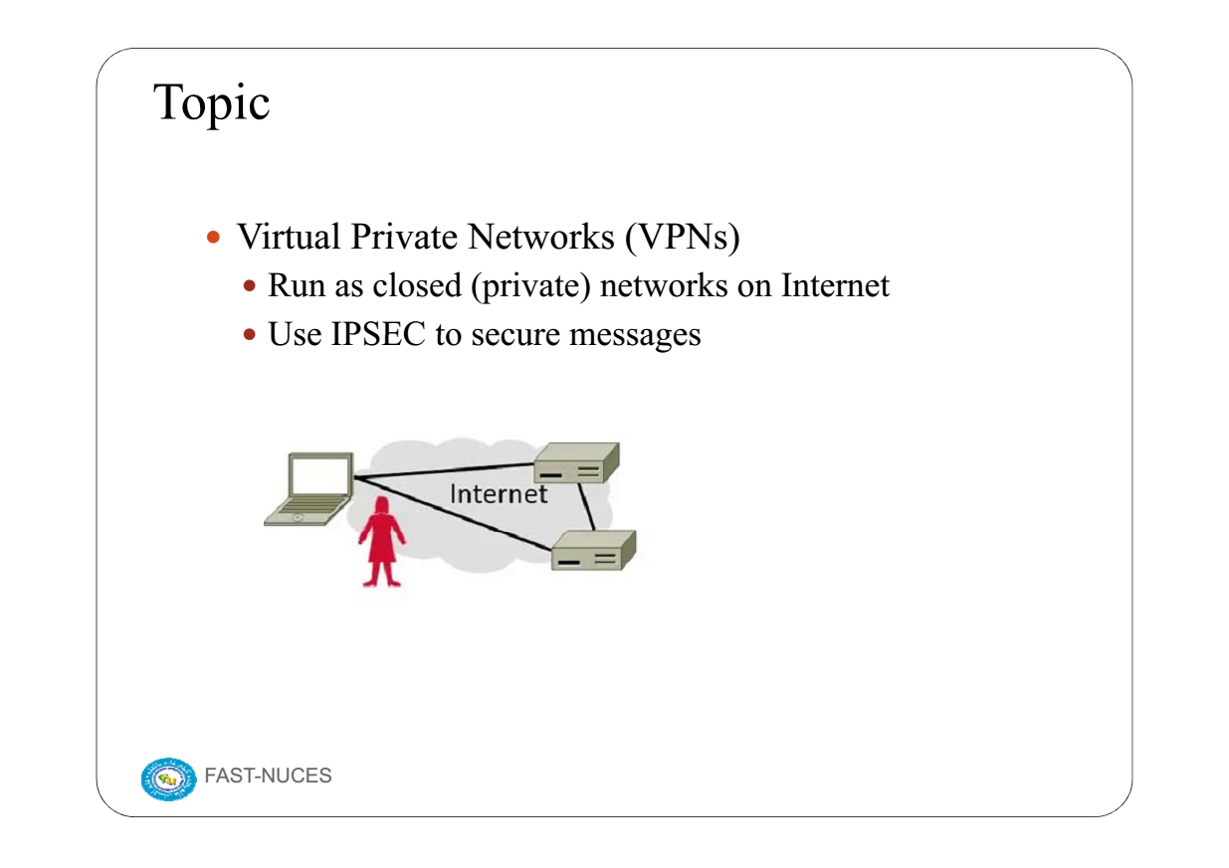

Slide 3
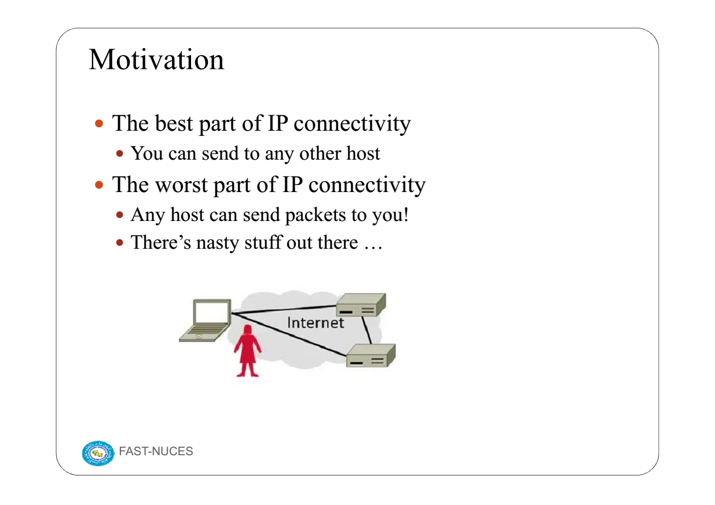

Slide 4
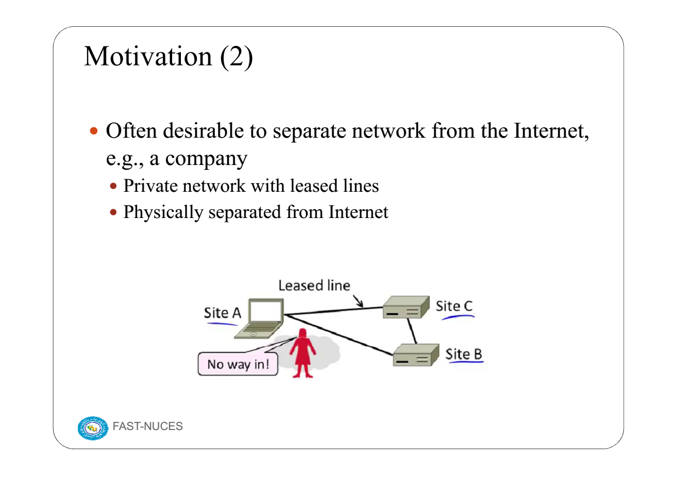

Slide 5
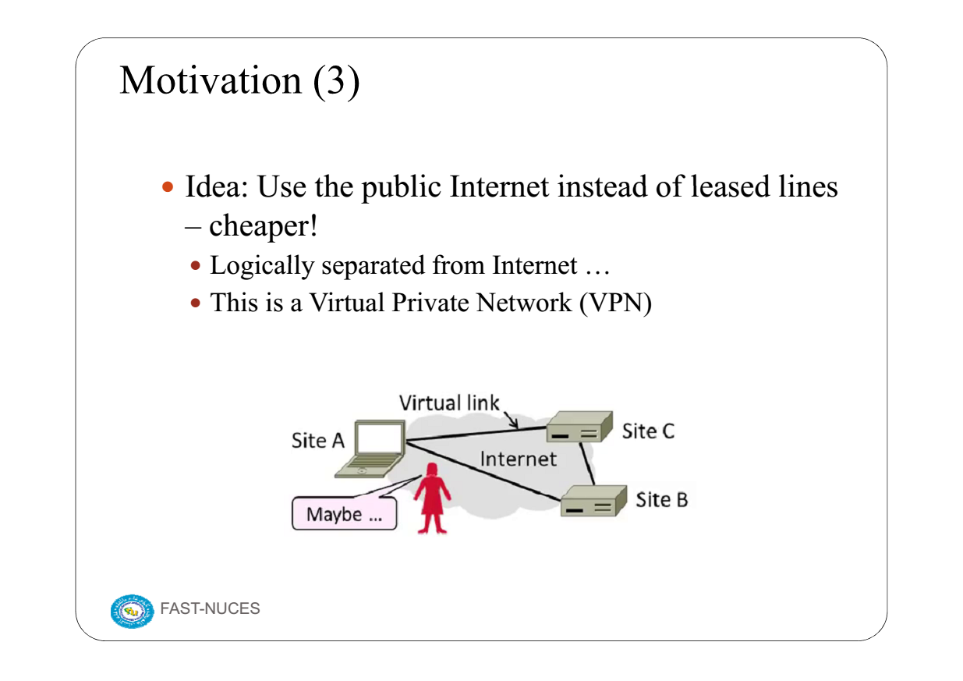

Slide 6
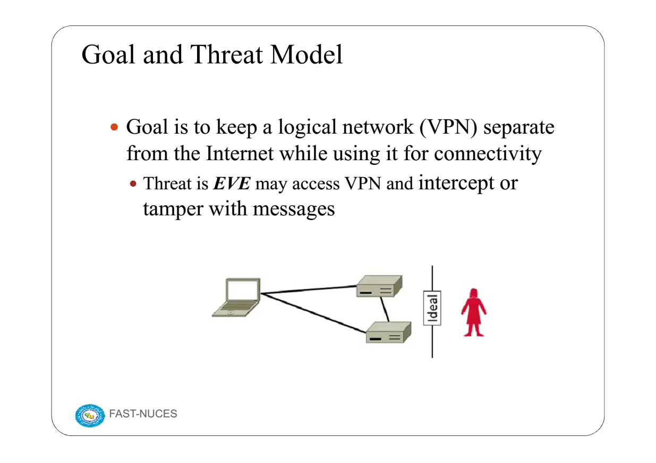

Slide 7
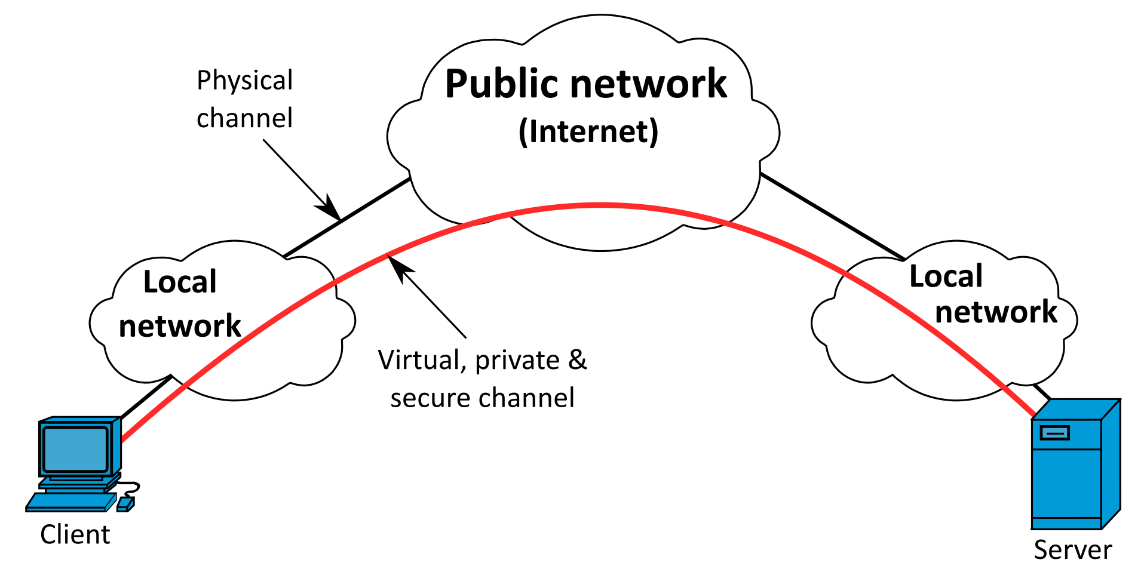
A virtual private network (VPN) extends a private network across a public network and enables users to send and receive data across shared or public networks as if their computing devices were directly connected to the private network.
Applications running across a VPN may therefore benefit from the functionality, security, and management of the private network. Encryption is a common, although not an inherent, part of a VPN connection
OR
VPN: It stands for Virtual Private Network. It is a mechanism of employing encryption, authentication and integrity protection so that we can use public network as private network. It simulate a private network over public network. It allows users to remotely access a private network.

Slide 8
VPN technology was developed to provide access to corporate applications and resources to remote users^{[dubious – discuss]}, mobile users^{[dubious – discuss]}, and to branch offices. For security, the private network connection may be established using an encrypted layered tunneling protocol, and users may be required to pass various authentication methods to gain access to the VPN. In other applications, Internet users may secure their connections with a VPN to circumvent geo-blocking and censorship or to connect to proxy servers to protect personal identity and location to stay anonymous on the Internet. Some websites, however, block access to known IP addresses used by VPNs to prevent the circumvention of their geo-restrictions,^{[2]} and many VPN providers have been developing strategies to get around these blockades.
A VPN is created by establishing a virtual point-to-point connection through the use of dedicated circuits or with tunneling protocols over existing networks.^{[2]} A VPN available from the public Internet can provide some of the benefits of a wide area network (WAN). From a user perspective, the resources available within the private network can be accessed remotely.

Slide 9
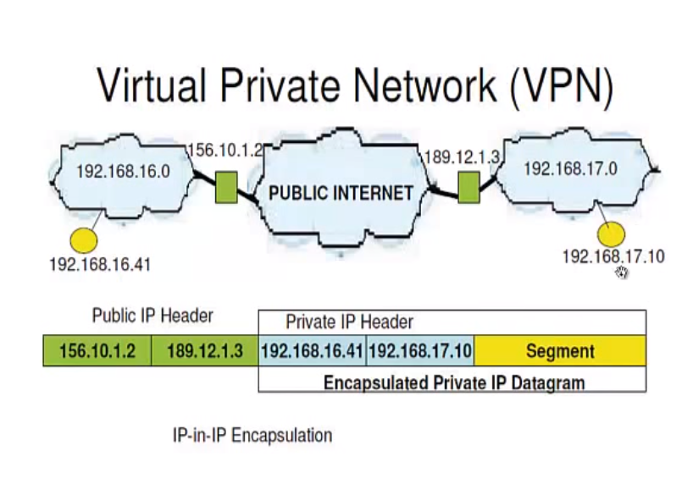
IP in IP is an IP tunneling protocol that encapsulates one IP packet in another IP packet. To encapsulate an IP packet in another IP packet, an outer header is added with SourceIP, the entry point of the tunnel and the Destination point, the exit point of the tunnel. While doing this, the inner packet is unmodified (except the TTL field, which is decremented). The Don't Fragment and the Type Of Service fields should be copied to the outer packet. If the packet size is greater than the Path MTU, the packet is fragmented in the encapsulator, as the outer header should be included. The decapsulator will reassemble the packet.

Slide 10
Tunelling is the technique of putting an integrated data packet into another packet (contains routing information) and sending it over the internet. The packets travel through a path which is known as tunnel. To secure a tunelled transmission against interception, all traffic over a VPN is encrypted for safety

Slide 11
Types of Virtual Private Network (VPN) and its Protocols
Virtual Private Network (VPN) is basically of 2 types:
Remote Access VPN: Remote Access VPN permits a user to connect to a private network and access all its services and resources remotely.
The connection between the user and the private network occurs through the Internet and the connection is secure and private. Remote Access VPN is useful for home users and business users both.An employee of a company, while he/she is out of station, uses a VPN to connect to his/her company’s private network and remotely access files and resources on the private network. Private users or home users of VPN, primarily use VPN services to bypass regional restrictions on the Internet and access blocked websites. Users aware of Internet security also use VPN services to enhance their Internet security and privacy.
2.Site to Site VPN: A Site-to-Site VPN is also called as Router-to-Router VPN and is commonly used in the large companies. Companies or organizations, with branch offices in different locations, use Site-to-site VPN to connect the network of one office location to the network at another office location

Slide 12
Intranet based VPN: When several offices of the same company are connected using Site-to-Site VPN type, it is called as Intranet based VPN.
Extranet based VPN: When companies use Site-to-site VPN type to connect to the office of another company, it is called as Extranet based VPN.
Basically, Site-to-site VPN create a imaginary bridge between the networks at geographically distant offices and connect them through the Internet and sustain a secure and private communication between the networks. In Site-to-site VPN one router acts as a VPN Client and another router as a VPN Server as it is based on Router-to-Router communication. When the authentication is validated between the two routers only then the communication starts.

Slide 13
Types of Virtual Private Network (VPN) Protocols:
Internet Protocol Security (IPSec):
Internet Protocol Security, known as IPSec, is used to secure Internet communication across an IP network. IPSec secures Internet Protocol communication by verifying the session and encrypts each data packet during the connection.IPSec runs in 2 modes:
(i) Transport mode
(ii) Tunneling mode
The work of transport mode is to encrypt the message in the data packet and the tunneling mode encrypts the whole data packet. IPSec can also be used with other security protocols to improve the security system.
2. Layer 2 Tunneling Protocol (L2TP): L2TP or Layer 2 Tunneling Protocol is a tunneling protocol that is often combined with another VPN security protocol like IPSec to establish a highly secure VPN connection. L2TP generates a tunnel between two L2TP connection points and IPSec protocol encrypts the data and maintains secure communication between the tunnel.

Slide 14
3. Point–to–Point Tunneling Protocol (PPTP):
PPTP or Point-to-Point Tunneling Protocol generates a tunnel and confines the data packet. Point-to-Point Protocol (PPP) is used to encrypt the data between the connection. PPTP is one of the most widely used VPN protocol and has been in use since the early release of Windows. PPTP is also used on Mac and Linux apart from Windows.
4. SSL and TLS: SSL (Secure Sockets Layer) and TLS (Transport Layer Security) generate a VPN connection where the web browser acts as the client and user access is prohibited to specific applications instead of entire network. Online shopping websites commonly uses SSL and TLS protocol. It is easy to switch to SSL by web browsers and with almost no action required from the user as web browsers come integrated with SSL and TLS. SSL connections have “https” in the initial of the URL instead of “http”.
5. OpenVPN: OpenVPN is an open source VPN that is commonly used for creating Point-to-Point and Site-to-Site connections. It uses a traditional security protocol based on SSL and TLS protocol.
6. Secure Shell (SSH): Secure Shell or SSH generates the VPN tunnel through which the data transfer occurs and also ensures that the tunnel is encrypted. SSH connections are generated by a SSH client and data is transferred from a local port on to the remote server through the encrypted tunnel.

Slide 15
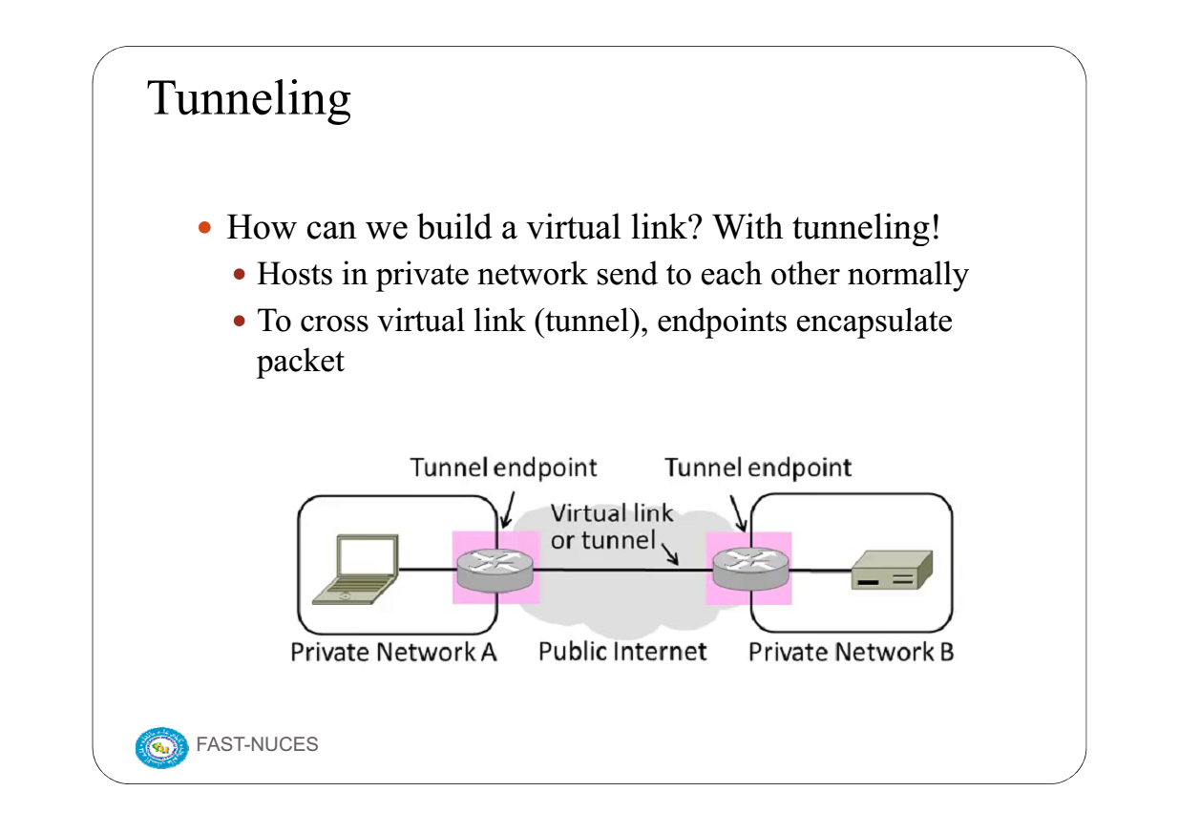

Slide 16
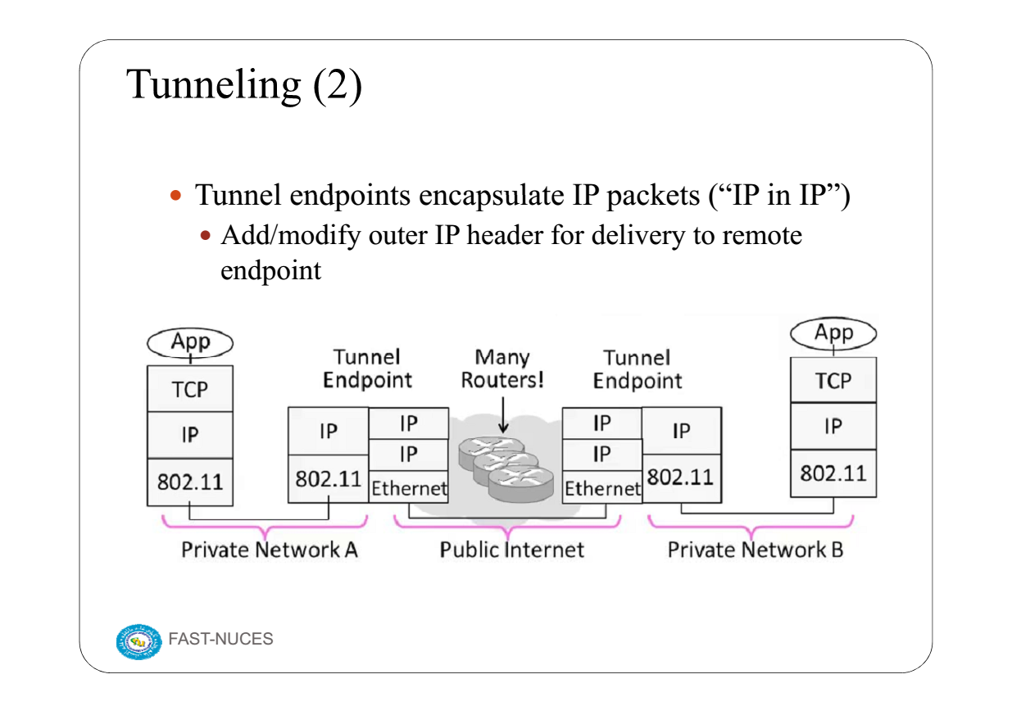

Slide 17
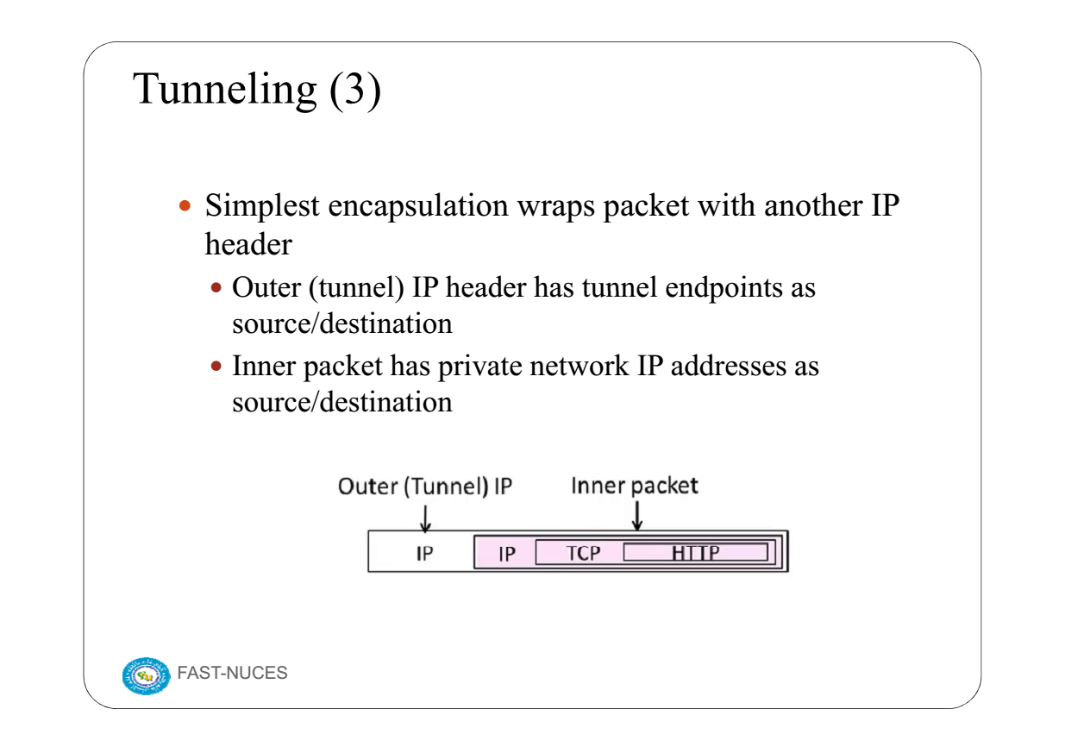

Slide 18
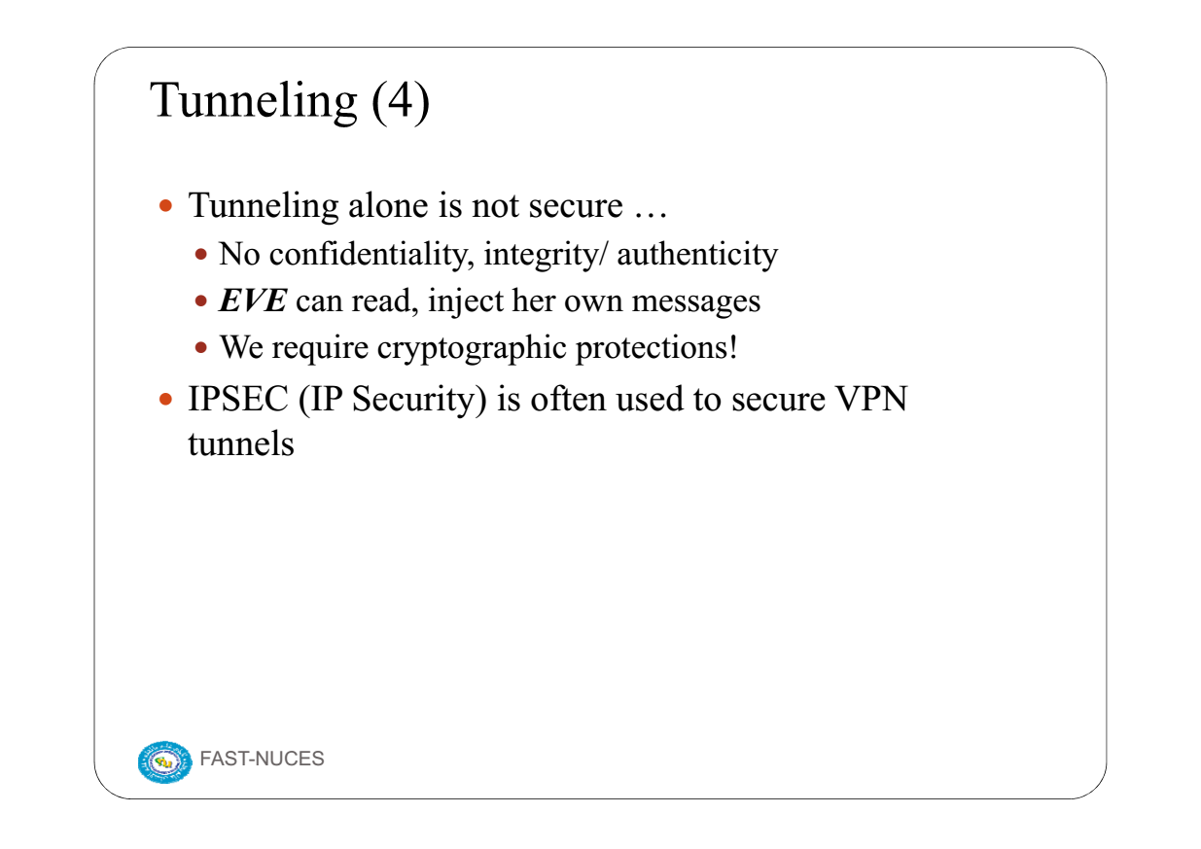

Slide 19
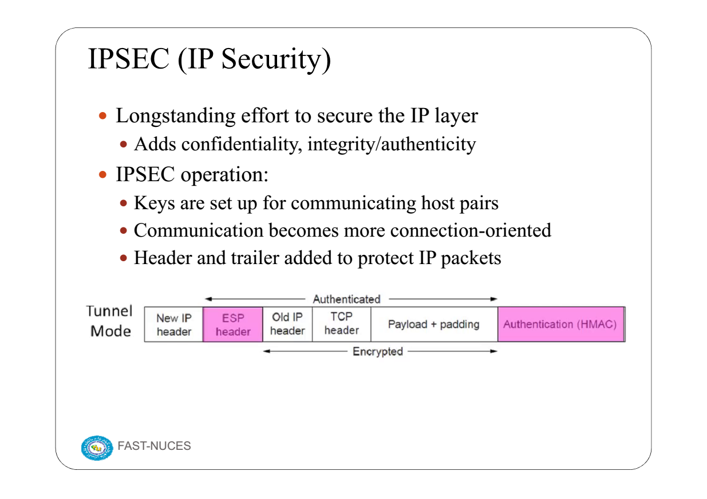

Slide 20
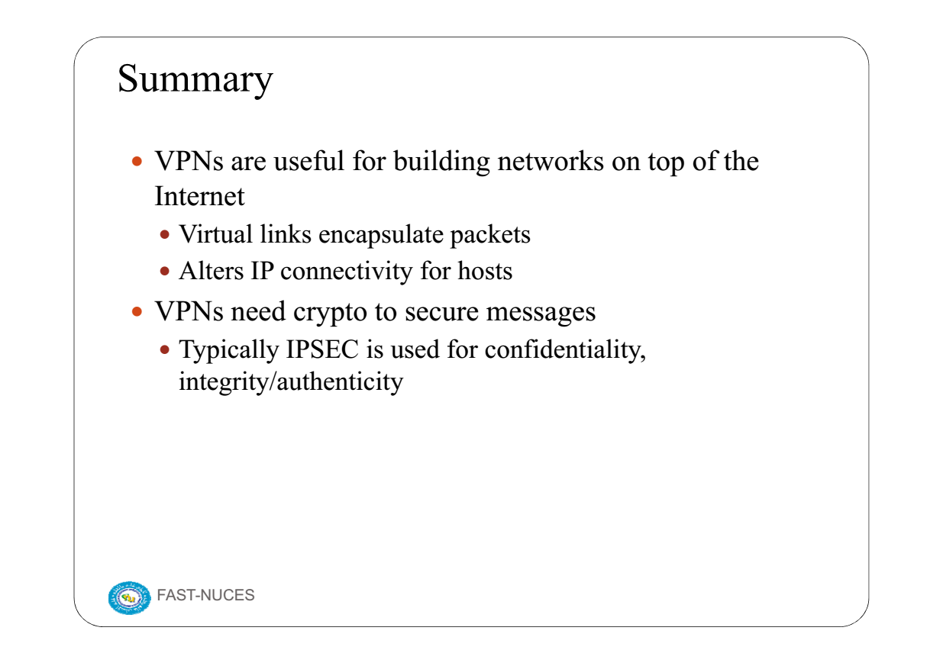

Slide 21
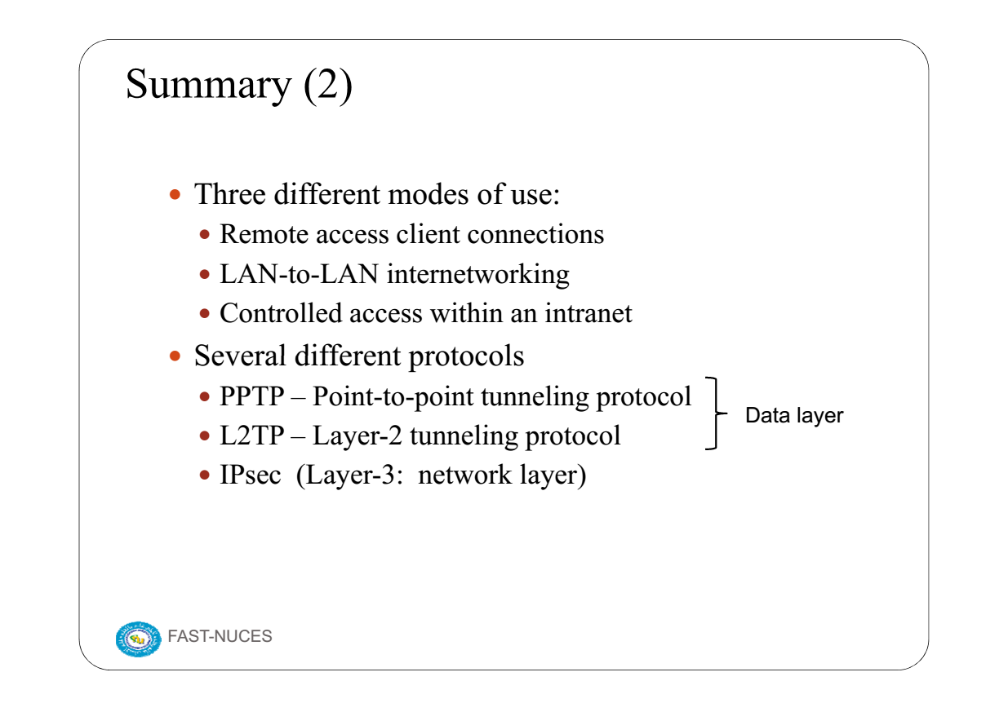

Slide 22
